Slide 1

INFORMATION HIDING
Reversible Data Hiding
Adib Nikjou, Shiraz University of Technology, Summer 2025

Slide 2
Lecture Overview Reversible data hiding
1. Introduction to Reversible Data Hiding
Motivation for Reversible Data Hiding
Fundamental Principles
Common Ways to Hide Data in a Reversible Manner
2. Introduction to Lossless Compression Methods
3. Introduction to Histogram Shifting Methods
4. Introduction to Difference Expansion Methods
5. A Comparison between Methods

Slide 3
Introduction to Reversible Data Hiding

Slide 4
What is Reversible Data Hiding?
Definition:
A steganographic technique that allows complete restoration of the original image after data extraction
Key Characteristic:
Perfect reversibility - no permanent modifications to the cover image
Watermark
Host Image
EMBEDDER
CHANNEL
EXTRACTOR
Host Image
Watermark

Slide 5
Why Reversibility Matters?
Integrity Preservation:
Critical for applications where image authenticity is paramount
Dual Purpose:
Enables both data hiding and perfect image recovery
Quality Assurance:
Ensures no degradation of original content
Medical Imaging, Military and Intelligence, Digital Art and Cultural Heritage

Slide 6
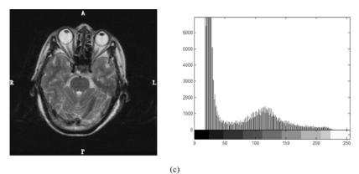
Critical Applications
Medical Imaging
Patient Privacy: Embedding patient data directly in medical scans
Diagnostic Integrity: Ensuring scan authenticity for legal purposes
Workflow Efficiency: Linking metadata with images seamlessly
Example: MRI scans with embedded patient records

Slide 7

Critical Applications
Military and Intelligence
Classified Information: Hiding sensitive data in routine images
Authentication: Verifying image source and integrity
Covert Communication: Secure data transmission channels
Chain of Custody: Maintaining evidence integrity

Slide 8

USA Defense Technical Information Center ( DTIC ) Report

Slide 9
Critical Applications
Digital Art and Cultural Heritage
Copyright Protection: Embedding ownership information
Authenticity Verification: Proving artwork originality
Metadata Preservation: Storing creation details and provenance
Museum Applications: Digital archival with embedded documentation

Slide 10
Method Classification Overview
Three Main Categories
The evolution of reversible data hiding has produced three distinct methodological approaches, each with unique strengths and applications:
Lossless Compression-Based (1994)
- Utilizes redundancy in image data
- High computational complexity
- Moderate capacity and quality

Slide 11
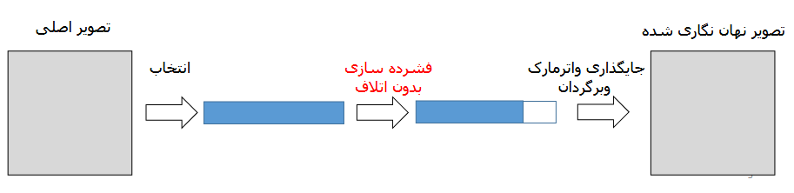





Method Classification Overview
Lossless Compression-Based (1994)
Original Image
Watermarked Image
Lossless Compression
Embed watermark and reconstruct
Select

Slide 12
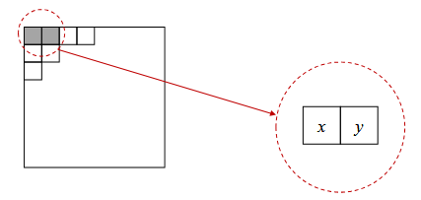
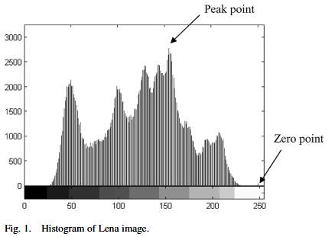
Method Classification Overview
Difference Expansion (2002-2003)
- Exploits pixel correlations
- Balanced performance metrics
- Widely adopted and extended
Histogram Shifting (2003-2006)
- Leverages statistical properties
- High quality, lower capacity
- Computationally efficient

Slide 13
Method 1: Lossless Compression-Based Techniques

Slide 14
Historical Context
Pioneer:
Barton (1994) - first reversible data hiding method
Innovation:
Using compression redundancy for data embedding
Impact:
Established the foundation for all subsequent methods
The earliest reference to reversible data embedding we could find is the Barton patent, filed in 1994. In his invention, the bits to be overlayed will be compressed and added to the bitstring, which will be embedded into the data block.

Slide 15





Core Methodology
Original Image
Watermarked Image
Lossless Compression
Embed watermark and reconstruct
Select

Slide 16
Core Methodology
Step 1: Data Selection
Select specific image regions or bit planes
Common choices: LSBs (Least Significant Bits) of pixels
Criteria: Redundancy level and visual impact
Step 2: Lossless Compression
Apply compression algorithms (e.g., LZW, Huffman coding)
Create free space by removing redundancy
Maintain perfect reconstruction capability
Step 3: Data Embedding
Insert secret data into compressed space
Append compression parameters
Generate location map for reconstruction

Slide 17
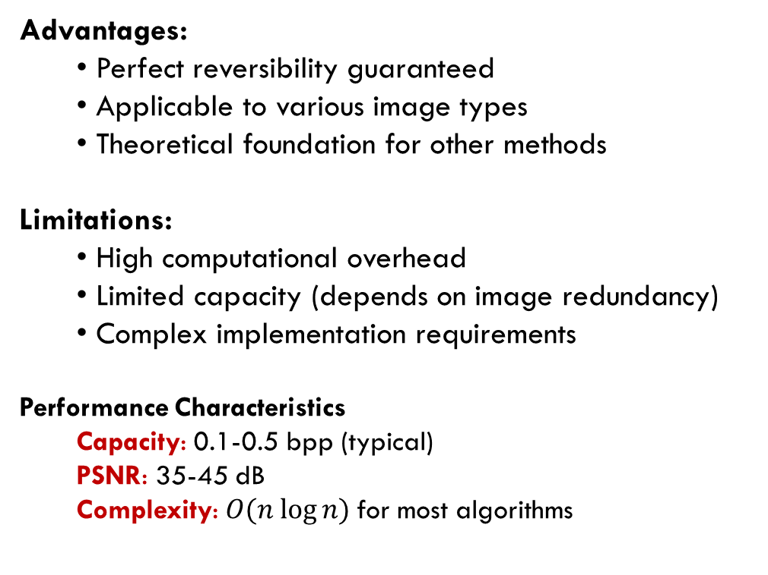
Advantages and Limitations
Advantages:
Perfect reversibility guaranteed
Applicable to various image types
Theoretical foundation for other methods
Limitations:
High computational overhead
Limited capacity (depends on image redundancy)
Complex implementation requirements
Performance Characteristics
Capacity: 0.1-0.5 bpp (typical)
PSNR: 35-45 dB
Complexity: $O(n log⁡n)$for most algorithms
While compression-based methods established the field, researchers sought more efficient approaches, leading to the development of difference expansion techniques...

Slide 18
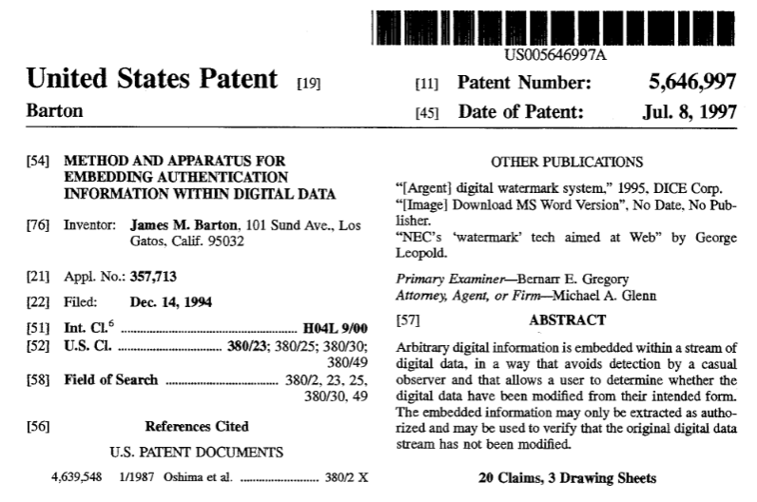

Slide 19
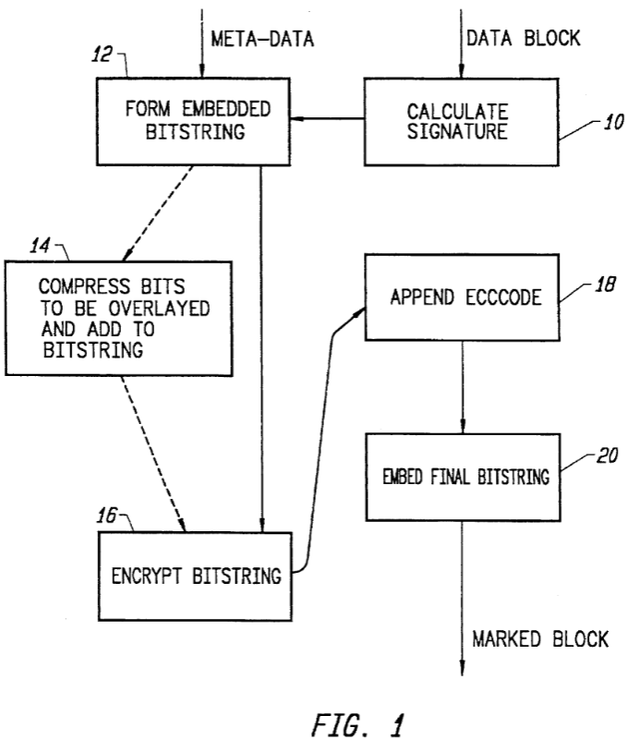
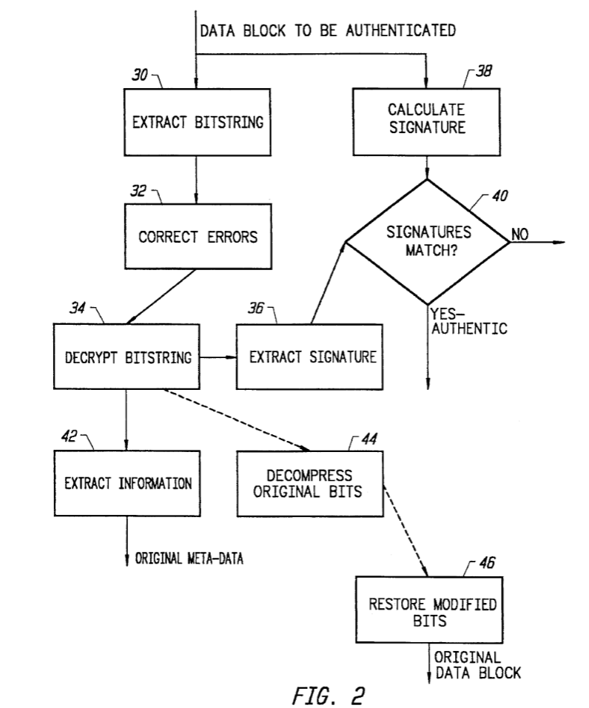
Embedding
Retrieval

Slide 20
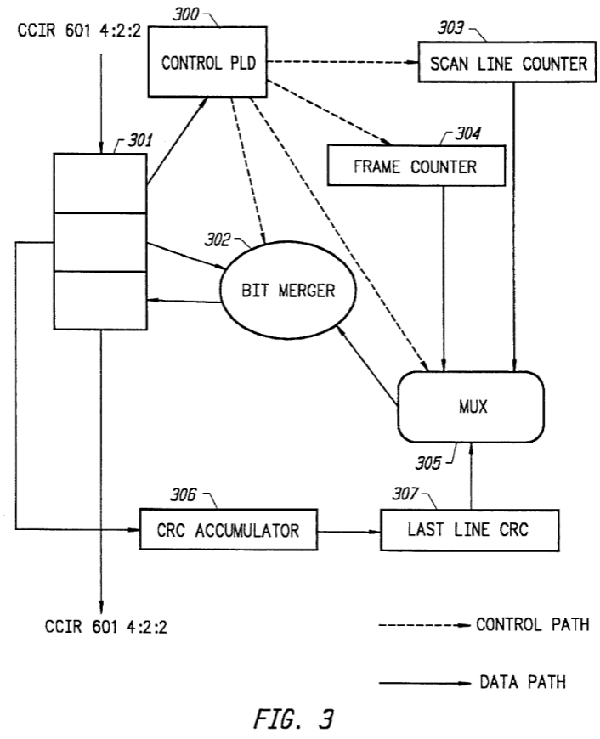
Authentication Process

Slide 21
Method 2: Difference Expansion (DE) Techniques

Slide 22
Historical Development
Innovator:
Jun Tian (2002 preliminary, 2003 complete)
Breakthrough:
Direct pixel manipulation without compression
Impact:
Became the most widely studied RDH method

Slide 23
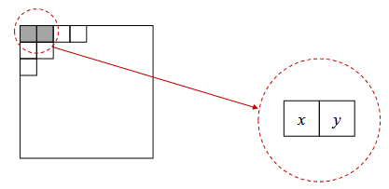
Fundamental Concept
Pixel Pair Processing
1) Image Partitioning:
Divide image into pixel pairs (x, y)
2) Calculate Parameters:
Integer Average: l = floor((x + y) / 2)
Difference: h = x – y
3) Expansion Condition: Check if expansion is possible

Slide 24
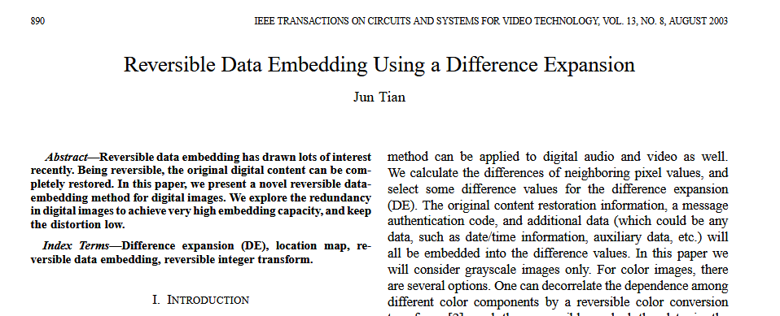
Fundamental Concept

Slide 25
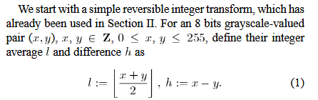

Mathematical Foundation

Slide 26
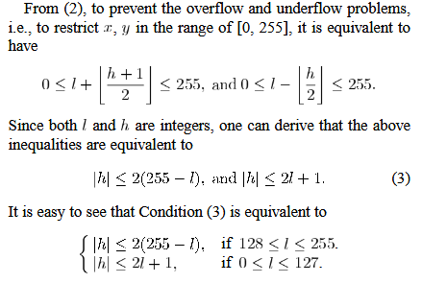
Mathematical Foundation

Slide 27
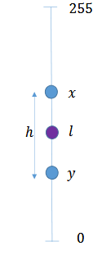
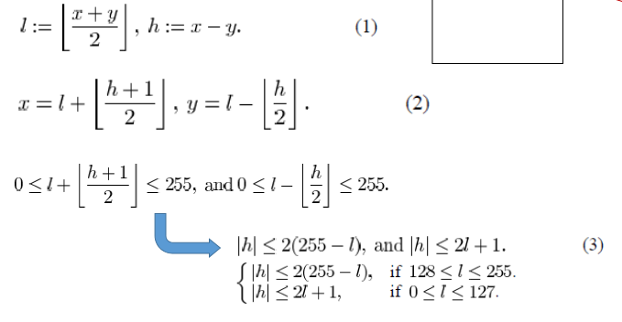

Mathematical Foundation

Slide 28
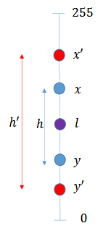
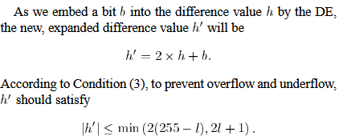
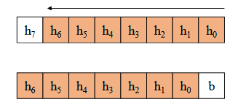
Mathematical Foundation

Slide 29
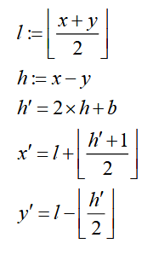

Mathematical Foundation
Creates Embedding Space
(Expands the difference)
$$0 ≤ x^{′}, y′ ≤ 255$$

Slide 30
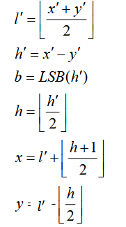
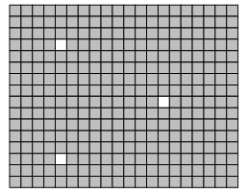

Mathematical Foundation
But Sometimes our new $x^{′}$ and $y^{′}$ becomes larger than 255 or smaller than 0 !
Because of this, We need something called Location map. Pixels that excite the range of [255, 0] are marked as Non-expandable or Non-changeable.
Watermark Bit
Reversible !

Slide 31
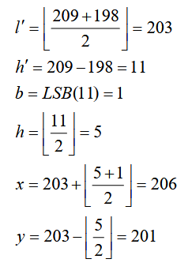

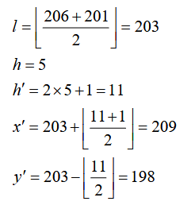
Example
Extracting
Embedding

Slide 32
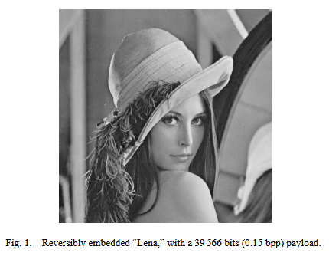
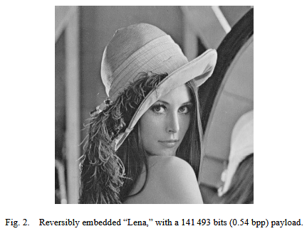
Some results from the original paper

Slide 33
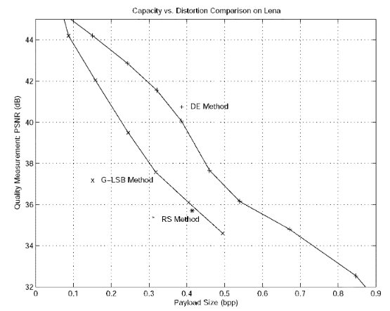
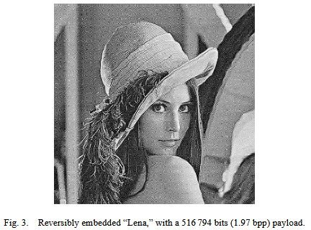
Some results from the original paper

Slide 34
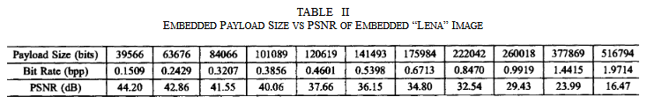
Some results from the original paper

Slide 35
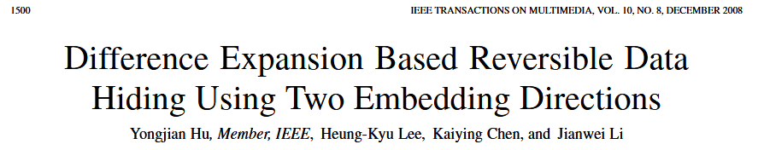
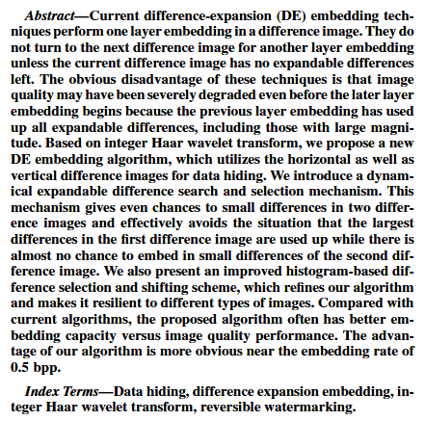
another paper
Row and Column Difference Expansion

Slide 36
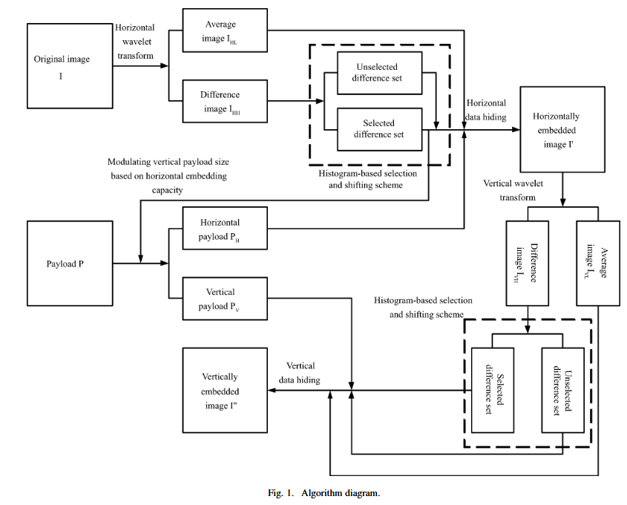

Slide 37
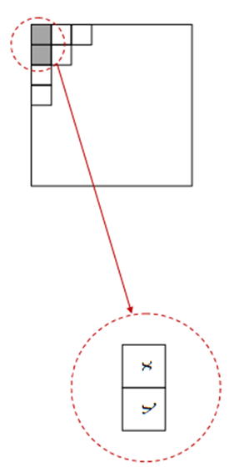
another paper

Slide 38
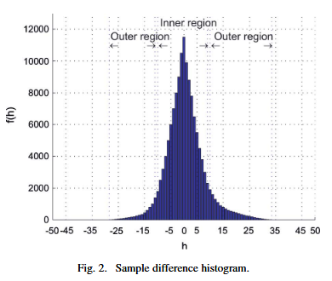
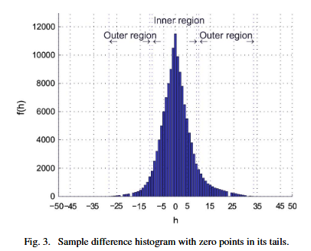
another paper

Slide 39
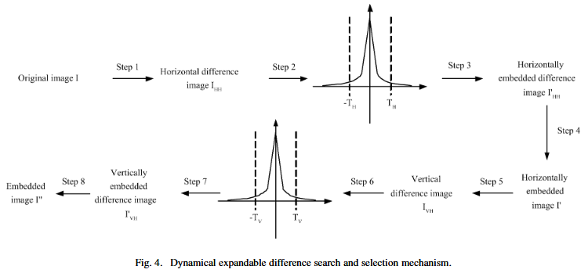
another paper

Slide 40
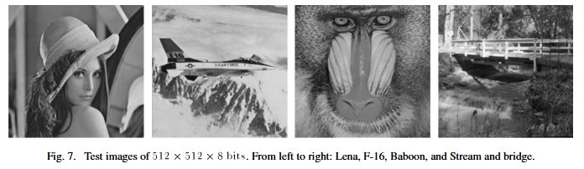
Results

Slide 41
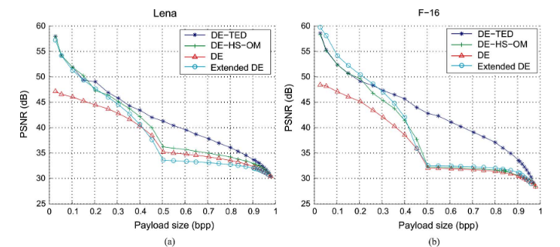
Results

Slide 42
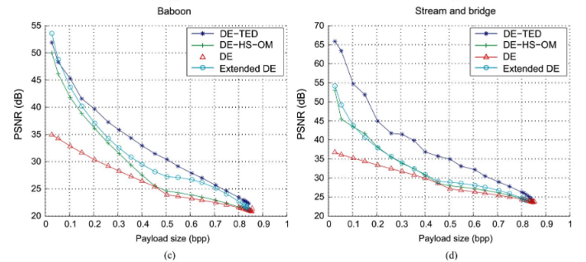
Results

Slide 43
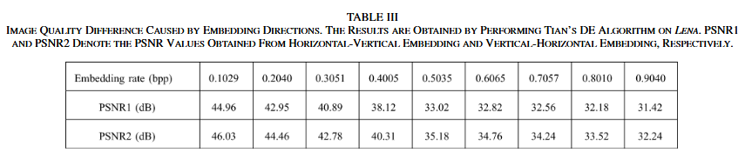
Results

Slide 44
Method 3: Histogram Shifting Techniques

Slide 45
Conceptual Innovation
Developers:
Zhicheng Ni et al. (2003 preliminary, 2006 complete)
Key Insight:
Natural images don't use all grayscale values uniformly
Advantage:
Minimal distortion through statistical manipulation

Slide 46

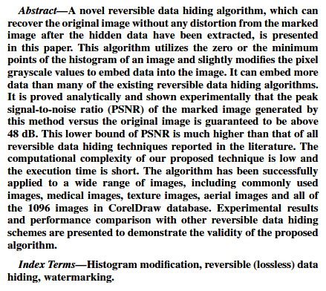
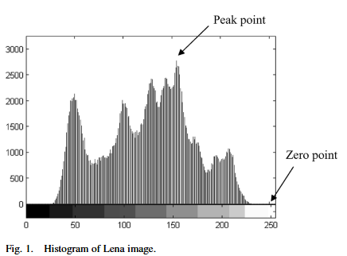

Slide 47
Core Principle
Histogram Analysis
Observation:
Natural images have irregular intensity distributions
Opportunity:
Empty bins and peak frequencies can be exploited
Strategy:
Shift histogram segments to create embedding space

Slide 48
Methodology Details
Histogram Analysis
Observation:
Natural images have irregular intensity distributions
Opportunity:
Empty bins and peak frequencies can be exploited
Strategy:
Shift histogram segments to create embedding space

Slide 49
Methodology Details
Step 1: Histogram Construction
Analyze intensity distribution of target image
Identify peak point (maximum frequency)
Locate zero point (unused intensity value)

Slide 50

Methodology Details
Step 2: Histogram Shifting
Shift the Histogram to the Zero Point.
Step 3: Data Embedding
Data bit = 0: Keep pixel at peak value
Data bit = 1: Change pixel to peak+1 value
Result: Peak frequency splits between two values

Slide 51

Methodology Details
Step 4: Recovery Process
If zero points are unavailable, we must select an intensity with minimum existence, then save those bits and locations as overhead. This overhead must then be embedded as the watermark.

Slide 52
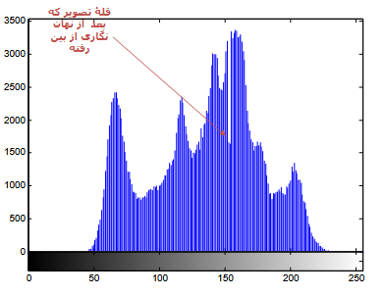
Some considerations
We should also consider that the peak in the histogram vanishes after embedding the watermark bits. This may result in the identification of watermarked images.

Slide 53
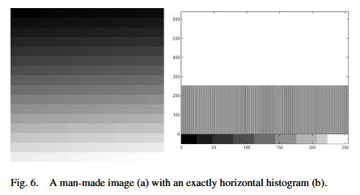
Some considerations
This method does not work with Pixel values distributed Uniformly

Slide 54
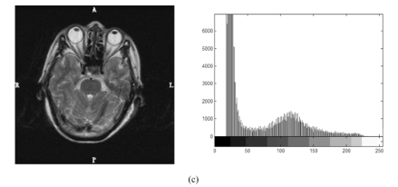
Some considerations
But this method works just fine for these types of images.

Slide 55
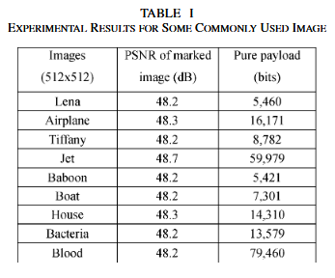
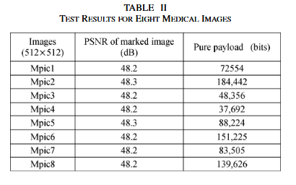
Results

Slide 56
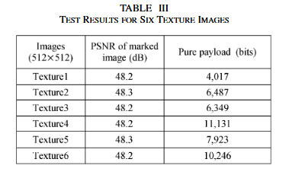
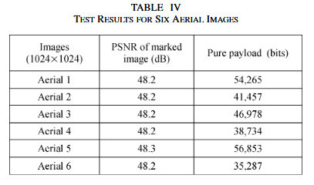
Results

Slide 57
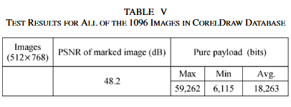
Results

Slide 58


Also good to know

Slide 59

Also good to know
So, in the worst-case scenario! We have:

Slide 60


But …
But what would happen if we use histogram shifting in the transform domain?
We know that transform coefficients are typically dense around zero, which makes their histogram ideal for this technique.
Third Coefficient DCT Distribution
Second Coefficient
DCT Distribution

Slide 61

But …
Link to paper: [ Link ]

Slide 62

But …
The Capacity is Higher !

Slide 63
A Comparison between Methods

Slide 64

Table of comparison

